Slide 1

INFRASTRUCTURE SOLUTIONS OF CLOUD
Module Number: 01
Module Name: Introduction to Microsoft Azure Virtual machines

Slide 2
Syllabus
Introduction to Microsoft Azure Virtual Machines
Introduction to Azure VM, Resource planning with Basic and standard, VM pricing, Difference between basic and standard VM, Creating virtual machines, Choosing the type of VM, Configuring DNS address, Configuring endpoints, Connecting to virtual machine, Implementing the lifecycle of a virtual machine, Uploading and downloading virtual hard disks Attaching an empty hard disk to VM, Creating VM from a custom image Deleting images and disks

Slide 3
Introduction to Microsoft Azure Virtual Machines
Aim:
To equip the students with benefits of Virtual Machine on Azure Platform.

Slide 4
Introduction to Microsoft Azure Virtual Machines
Objectives:
The objectives of this module are:
Learning Types of Azure Virtual Machine and design principles.
Understanding the Resource Planning in Azure Platform.
Evaluating an empty hard disk to Virtual Machine.
Configuring DNS on Azure Virtual Machine.

Slide 5
Introduction to Microsoft Azure Virtual Machines
Outcomes:
At the end of this module, you are expected to:
Deploying and Manage Virtual Machine on Azure Platform
Managing Disk Images on Azure Virtual Machine
Understanding the basic fundamentals of microsoft azure
Implementing the techniques understand the methods to detecting the images and disc

Slide 6
Table of Content
Introduction to Microsoft Azure Virtual Machines
Introduction to Azure VM
Resource planning with Basic and standard VM pricing
Difference between basic and standard VM
Creating virtual machines
Choosing the type of VM
Configuring DNS address - Configuring endpoints - Connecting to virtual machine
Implementing the lifecycle of a virtual machine
Uploading and downloading virtual hard disks
Attaching an empty hard disk to VM
Creating VM from a custom image
Deleting images and disks

Slide 7
Introduction to Microsoft Azure Virtual Machines
Introduction to Azure VM
Azure Virtual Machines (VM) are becoming more popular among IT infrastructures. Microsoft Azure is one of the leading cloud providers that offer various kinds of cloud-based services to bring an integrated solution platform.
Azure Virtual Machines are one of the on-demand computing resources that come under Infrastructure as a Service (Iaas) category in Azure.
Azure services are mainly used to build and develop cloud-based solutions in various organizations.
Due to the advantages it provides in terms of virtualization technology, Azure VM has grown significantly in popularity among businesses.

Slide 8
Introduction to Microsoft Azure Virtual Machines
Resource Planning with Basic and Standard VM Pricing
Azure VM pricing is based on the following instance properties:
Region
Physical location of the machine. Azure offers 60 regions worldwide, available in 140 countries.
Operating system (OS)
Linux or Windows are available.
Tier
Sets of instances and Its service level.
License Type
OS only or software license attached (BizTalk / SQL server).
Instance Type
The type defines the size of the instance, and Storage attached

Slide 9
Introduction to Microsoft Azure Virtual Machines
Resource Planning with Basic and Standard VM Pricing
Azure VM Tiers
Azure VM sets a service level tier for each instance, affecting the possible resources and services consumed by the instance.
There are two main tiers for compute:
Standard
Basic

Slide 10
Introduction to Microsoft Azure Virtual Machines
Resource planning with Basic and standard VM pricing
Basic and Standard pricing tier is about the CPU power, IOPS, etc.
these virtual machine breaks down as followed:
Basic pricing tier: optimized for dev/test, these virtual machines have capabilities similar to the standard tier.
However, they do not support the Azure load balancer or auto-scaling, IOPS is slower than for Standard.
Standard Pricing tier: provide better CPU performance and IOPS than basic tier.

Slide 11
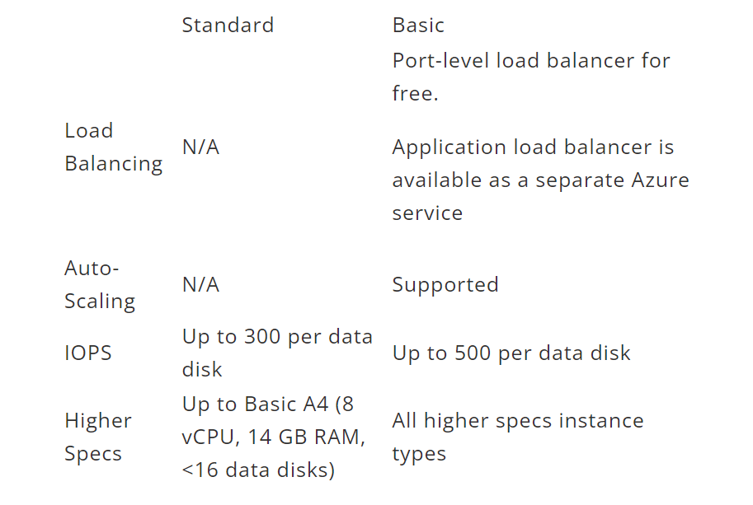
Introduction to Microsoft Azure Virtual Machines
Difference between basic and standard VM
Source: https://faddom.com/azure-vms-pricing/

Slide 12
Introduction to Microsoft Azure Virtual Machines
Creating Virtual Machines
Azure virtual machines can be Deployed through the Azure portal. This provides a browser-based user interface to create Virtual Machines and their related resources.
We have to create an Azure subscription, create a free account before you begin.
Sign in the Azure Portal

Slide 13
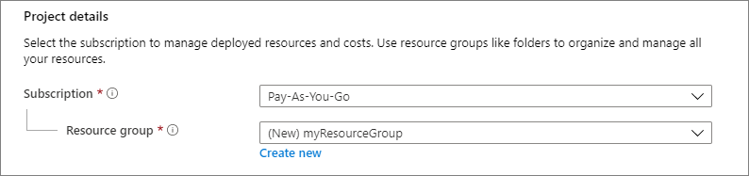
Introduction to Microsoft Azure Virtual Machines
Creating Virtual Machines
Enter virtual machines in the search.
In the Virtual machines page, select Create New and then Virtual machine.
To Create a virtual machine page will opens as shown below .
In the Basics tab, under Project details, make sure the correct subscription is selected and then choose to Create new resource group. Enter myResourceGroup for the name.
Source : https://docs.microsoft.com/en-us/azure/virtual-machines/windows/quick-create-portal#create-virtual-machine

Slide 14
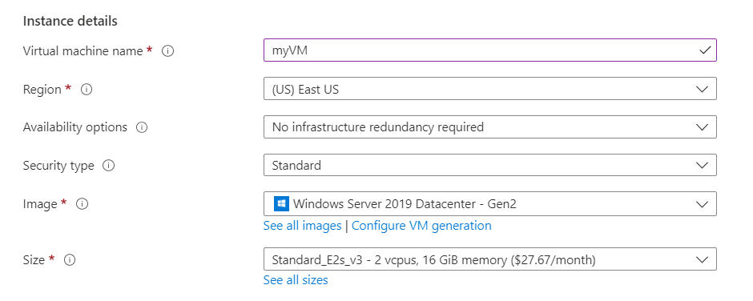
Introduction to Microsoft Azure Virtual Machines
Creating Virtual Machines
Source : https://docs.microsoft.com/en-us/azure/virtual-machines/windows/quick-create-portal#create-virtual-machine

Slide 15
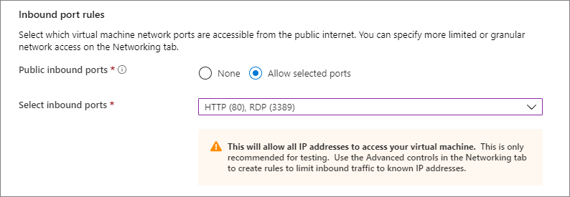
Introduction to Microsoft Azure Virtual Machines
Creating Virtual Machines
Under Inbound port rules, choose Allow selected ports and then select RDP (3389) and HTTP (80) from the drop-down.
Source : https://docs.microsoft.com/en-us/azure/virtual-machines/windows/quick-create-portal#create-virtual-machine

Slide 16
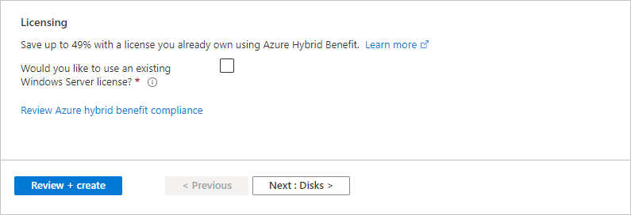
Introduction to Microsoft Azure Virtual Machines
Choosing the type of VM
Leave the remaining defaults and then select the Review + create button at the bottom of the page.
Screenshot showing the Review and create button at the bottom of the page
After validation runs, select the Create button at the bottom of the page.
After deployment is complete, select Go to resource.
Source: https://docs.microsoft.com/en-us/azure/virtual-machines/windows/quick-create-portal#create-virtual-machine

Slide 17
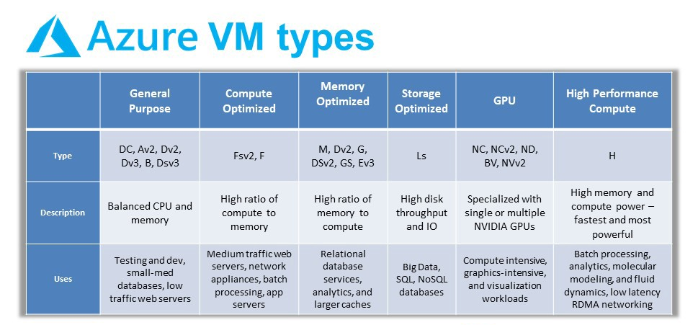
Introduction to Microsoft Azure Virtual Machines
Choosing the type of VM
Source : https://jaychapel.medium.com/microsoft-azure-vm-types-comparison-e7d031b4b588

Slide 18
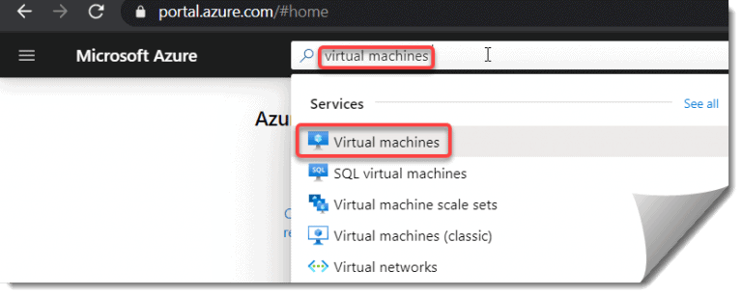
Introduction to Microsoft Azure Virtual Machines
Configuring DNS Address
Step- 1: Login to https://portal.azure.com/
Step- 2: Search for Virtual machines there.
Source: https://azurelessons.com/azure-virtual-machine-dns/

Slide 19
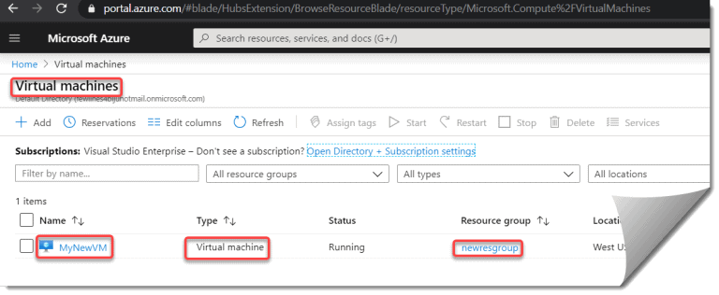
Introduction to Microsoft Azure Virtual Machines
Configuring DNS Address
Step- 3: You will see the list of VM created in your Azure subscription. It will show the VM name, Type, Status, Resource Group, Location, etc.
Source: https://azurelessons.com/azure-virtual-machine-dns/

Slide 20
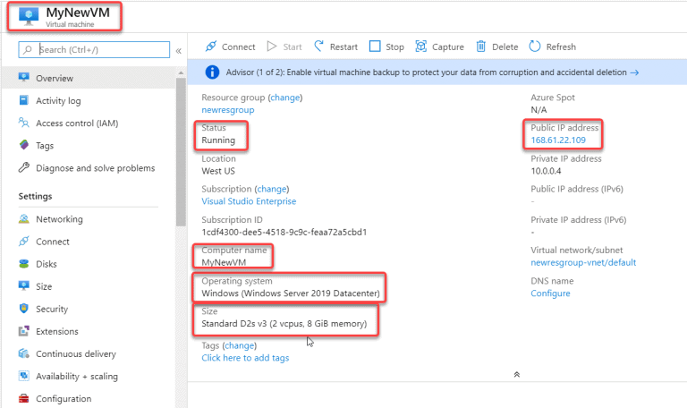
Introduction to Microsoft Azure Virtual Machines
Step- 4: Now click on the VM name. “MyNewVM” in my case. You can able to see the details of your virtual machine like Public IP address, status, Computer name, Operating system, Size etc.
Source: https://azurelessons.com/azure-virtual-machine-dns/

Slide 21
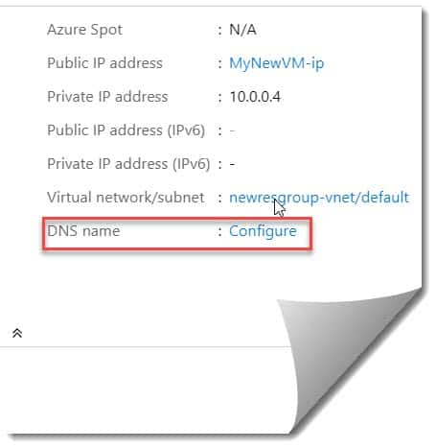
Introduction to Microsoft Azure Virtual Machines
Configuring DNS Address
Step- 5: You can also see the DNS name here. Click on the configure link.
Source: https://azurelessons.com/azure-virtual-machine-dns/

Slide 22
Introduction to Microsoft Azure Virtual Machines
Configuring DNS Address
Step- 5: You can also see the DNS name here. Click on the configure link.
Source: https://azurelessons.com/azure-virtual-machine-dns/

Slide 23
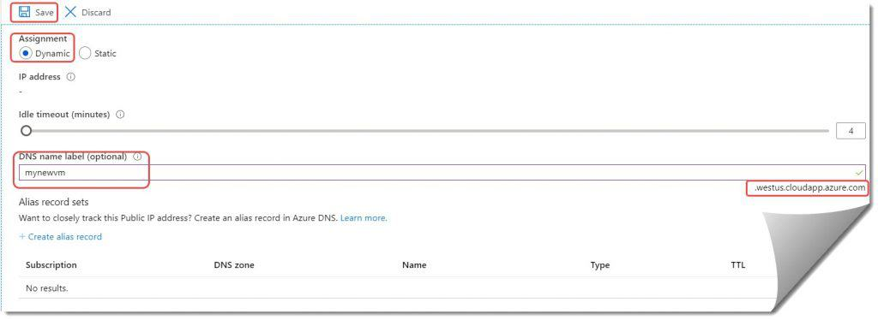
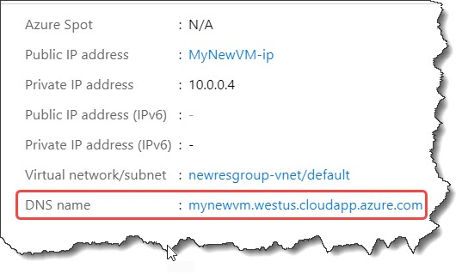
Introduction to Microsoft Azure Virtual Machines
Step- 6: Select the Assignment as Dynamic, Provide a name for the DNS in the DNS name label field. Then click on the Save button.
So now if you can see my DNS name is “mynewvm.westus.cloudapp.azure.com“. You can see it here on the Overview tab.
Source: https://azurelessons.com/azure-virtual-machine-dns/

Slide 24
Introduction to Microsoft Azure Virtual Machines
Configuring Endpoints
There is a section Azur Platform where endpoints can be set up when constructing a virtual machine.
PowerShell and Remote Desktop are the two default endpoints that are enabled when building a virtual machine.
What does an endpoint actually mean?
Virtual machines in the same cloud can automatically communicate with one another. But if we want them to talk to our own computer, we'll need an endpoint that is set up for that.
In essence, it involves opening a port to access the virtual computer. Remote access to services operating on virtual machines is made possible by an endpoint.
When building an endpoint, the public and private ports must be specified. In addition, turning on Access Control Lists enables secure access to an endpoint (ACL).

Slide 25
Introduction to Microsoft Azure Virtual Machines
Configuring Endpoints
Step 1
Login to your Azure subscription and create a virtual machine.
Step 2
Click on the virtual machine in the Grid view. Now, you will be in the Virtual machine properties blade Window. Select the option “Network Interfaces”. Under the essentials section, find the public IP address parameter and click on IP address.
Step 3
You will be redirected to IP configuration blade of the virtual machine. In this Window, click Configurations option under settings section.

Slide 26
Introduction to Microsoft Azure Virtual Machines
Configuring Endpoints
Step 4
In the opened view ,add desired DNS name in DNS name label(Optional). The important information to be noted here is the entered name should be available, else an error message will be thrown, as shown in the screenshot given below. Once the proper name is provided, save the current settings.
Steps 5
After the successful creation of DNS name, navigate to the main virtual machine grid view and click on the virtual machine. In properties Window, select Network Interfaces option under settings section. In the new blade, click on the Network security group and click Security group in the next Window.

Slide 27
Introduction to Microsoft Azure Virtual Machines
Configuring Endpoints
Step 6
In the new blade, click Network security group option and select the corresponding Security group in the Grid View.
Step 7
In the new blade, select the option Inbound security rules and click add button in the blade.

Slide 28
Introduction to Microsoft Azure Virtual Machines
Configuring Endpoints
Step 8
Provide the desired name and click save button. After saving it successfully, the endpoint can be viewed in the rules Grid View.
Step 9
Navigate to the virtual machines Grid View and click on the resource group with which the virtual machine is associated with.
Step 10
In the resource group property Window, select the “virtual machine ip” in the Grid View section. You can find DNS name of the virtual machine in the properties Window.

Slide 29
Connecting to Virtual Machine in Azure
Introduction to Microsoft Azure Virtual Machines
Select the virtual machine from the list.
At the beginning of the virtual machine page, select Connect.
Go to the Azure portal to connect to a VM. Search for and select Virtual machines.
On the Connect to virtual machine page, select RDP, and then select the appropriate IP address and Port number. In most cases, the default IP address and port should be used. Select Download RDP File. If the VM has a just-in-time policy set, you first need to select the Request access button to request access before you can download the RDP file. For more information about the just-in-time policy, see Manage virtual machine access using the just in time policy.
Open the downloaded RDP file and select Connect when prompted. You will get a warning that the .rdp file is from an unknown publisher. This is expected. In the Remote Desktop

Slide 30
Introduction to Microsoft Azure Virtual Machines
6. Use a different account by clicking More options in the Windows Security dialogue. Select OK after entering the account's login information for the virtual computer.
Local account: When you created the virtual machine, you typically gave a local account user name and password. In this instance, the virtual machine's name, which is entered as vm name username, is the domain.
Domain joined VM: Enter the user name in the format Domain Username if the VM is part of a domain. Additionally, the account must either belong to the Administrators group or have been given permission to access the virtual machine remotely.
Domain controller: Enter the user name and password for a domain administrator account for that domain if the VM is a domain controller.
7. Select Yes to verify the identity of the virtual machine and finish logging on.

Slide 31
Implementing the lifecycle of a Virtual Machine
The term "virtual machine lifecycle management" (VMLM) refers to a group of procedures that administrators can use to control the creation, delivery, use, and upkeep of virtual machines (VMs) over the course of their use.
An operating system (OS) or programme can be installed and run in a virtual machine (VM), which is a software implementation of a computing environment.
The virtual machine (VM) simulates a physical computer environment, but resource requests are handled by a virtualization layer that translates them to the underlying hardware.

Slide 32
Implementing the lifecycle of a Virtual Machine
A virtual machine (VM) may frequently outlive repeated hardware upgrades, resulting in an allegedly "immortal VM.“
Although the hypervisor is upgraded, the VM continues to run without taking into account changes in the hardware.
As long as there is no urgent need for new hardware, the VM continues to function mostly in the same way. However, after time, support becomes cumbersome and pointlessly expensive.
An enterprise may have virtual machines (VMs) running on a variety of major OS releases, necessitating the use of several antivirus, security, asset management, monitoring, and other tools as well as personnel.

Slide 33
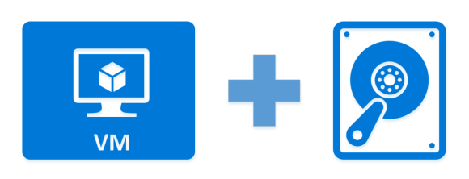
Introduction to Microsoft Azure Virtual Machines
Uploading and downloading Virtual Hard Disks
The virtual hard disc must be ready before you transfer a Windows virtual machine (VM) from on-premises to Azure (VHD or VHDX).
Generation 1 and Generation 2 VMs with fixed-size discs and VHD file format are both supported by Azure. On a generation 1 VM, the OS VHD can have a maximum size of 2 TB.
Source: https://claytonshieldsjr.medium.com/add-and-size-disks-in-azure-virtual-machines-576d8da969f5

Slide 34
Introduction to Microsoft Azure Virtual Machines
Attaching an empty hard disk to VM
How to use the Azure PowerShell module to copy a managed disc to a different region or upload a VHD from your local computer to an Azure managed disc.
You can upload a VHD up to 32 TiB in size straight into a managed drive using the upload managed disc procedure, commonly known as direct upload.
At the moment, normal HDD, standard SSD, and premium SSDs can all be directly uploaded. As of right now, ultra discs are not supported.
To restore client backups to managed discs while offering a backup solution for IaaS VMs in Azure, use direct upload.
The speed at which you can upload a VHD from an external source to Azure depends on your local bandwidth. When copying from or uploading to an Azure VM.

Slide 35
Introduction to Microsoft Azure Virtual Machines
Creating VM from a Custom Image
A managed VM image contains the information necessary to create a VM, including the OS and data disks.
The virtual hard disks (VHDs) that make up the image, including both the OS disks and any data disks, are stored as managed disks.
Before creating a new VM, you'll need to create a managed VM image to use as the source image and grant read access on the image to any user who should have access to the image.
One managed image supports up to 20 simultaneous deployments. Attempting to create more than 20 VMs concurrently, from the same managed image, may result in provisioning timeouts due to the storage performance limitations of a single VHD.

Slide 36
Introduction to Microsoft Azure Virtual Machines
Creating VM from a Custom Image
Use the portal
Go to the Azure portal to find a managed image. Search for and select Images.
Select the image you want to use from the list. The image Overview page opens.
Select Create VM from the menu.
Enter the virtual machine information. The user name and password entered here will be used to log in to the virtual machine. When complete, select OK. You can create the new VM in an existing resource group, or choose Create new to create a new resource group to store the VM.
Select a size for the VM. To see more sizes, select View all or change the Supported disk type filter.
Under Settings, make changes as necessary and select OK.
On the summary page, you should see your image name listed as a Private image. Select Ok to start the virtual machine deployment.

Slide 37
Introduction to Microsoft Azure Virtual Machines
Deleting Images and Disks
The networking and disc resources may not be deleted when you delete a virtual machine (VM), depending on how you do it. When you delete a VM, what additional resources are automatically deleted can be changed from the default settings.
Open the portal.
Select + Create a resource.
On the Create a resource page, under Virtual machines, select Create.
Make your choices on the Basics, then select Next : Disks >. The Disks tab will open.
Under Disk options, by default the OS disk is set to Delete with VM. If you don't want to delete the OS disk, clear the checkbox. If you're using an existing OS disk, the default is to detach the OS disk when the VM is deleted.

Slide 38
Introduction to Microsoft Azure Virtual Machines
Deleting Images and Disks
From Azure portal, browse to the storage container that contains unmanaged disks. Click on the disk to view the properties.
Ensure that the lease status is “unlocked” and that the lease state is “Available.” This indicates that the disk is not attached to any VMs. Click on Delete to remove the disks.
You can utilize Azure Advisor to find the unused virtual machines in your subscription.
The advanced evaluation model in Azure Advisor analyses metrics like CPU, memory, and network usage of VMs and finds underused VMs that can be terminated or eliminated.
The discs and those VMs can be deleted together to reduce your cloud storage costs.

Slide 39

Introduction to Microsoft Azure Virtual Machines
Summary
Virtual machines, also known as just VMs, are much like any other real computers, such as laptops, smartphones, and servers. It is equipped with a CPU, RAM, discs for file storage, and an internet connection in case that is required. VMs are frequently considered to be virtual computers or software-defined computers inside of real servers, although the components that make up your computer (referred to as hardware) are actual, physical, and exist solely as code.
Virtualization is the process of building a software-based or "virtual" version of a computer with dedicated resources from a physical host machine, like your desktop computer, and/or a distant server, such a server in a cloud provider's datacenter.
To ensure that the discs of VMs in an availability set are sufficiently isolated from one another to prevent a single point of failure, managed discs are integrated with availability sets. Disks are automatically inserted into various scale storage devices (stamps). Only the VM instances with discs on those stamps fail when a stamp fails due to hardware or software failure.

Slide 40
Introduction to Microsoft Azure Virtual Machines
Self Assessment ( Quiz)
Q1. In which year was Azure launched?
A. 2009
B. 2010
C. 2011
D. 2012
Answer: B

Slide 41
Introduction to Microsoft Azure Virtual Machines
Q2. Which of the following is the storage services provided by Azure?
A. Blob
B. Queue
C. Both A and B
D. Azure does not support storage services at all
Answer: C

Slide 42
Introduction to Microsoft Azure Virtual Machines
Q3. Which one of these is not a service provided by Azure?
A. compute
B. store
C. management
D. None of the above
Answer: D

Slide 43
Introduction to Microsoft Azure Virtual Machines
Q4. Which of the following element is a non-relational storage system for large-scale storage?
A. Application
B. Compute
C. Storage
D. None of the above
Answer: C

Slide 44
Introduction to Microsoft Azure Virtual Machines
Q5. Which of the following element allows you to create and manage virtual machines that serve either in a Web role and a Worker role?
A. Compute
B. Application
C. Storage
D. None of the mentioned
Answer: C

Slide 45
Introduction to Microsoft Azure Virtual Machines
Q6. Azure Storage plays the same role in Azure that ______ plays in Amazon Web Services.
A. EC3
B. S3
C. EC2
D. None of the mentioned
Answer: B

Slide 46
Introduction to Microsoft Azure Virtual Machines
Q7. Which of the following role in Microsoft Azure?
A. VM Role
B. Web Role
C. Worker Role
D. All of the above
Answer- D

Slide 47
Introduction to Microsoft Azure Virtual Machines
Q8. Are data disks provide support within scale sets?
A. Yes
B. No
Answer: A

Slide 48
Introduction to Microsoft Azure Virtual Machines
Q9. Which of the following application of Microsoft Azure?
A. Web Applications
B. Infrastructure Services
C. Media Services
D. All of the above
Answer: D

Slide 49
Introduction to Microsoft Azure Virtual Machines
Q10. A _________ role is a virtual machine instance running Microsoft IIS Web server that can accept and respond to HTTP or HTTPS requests.
A. Worker
B. Server
C. Web
D. Client
Answer: C

Slide 50

Introduction to Microsoft Azure Virtual Machines
Activity
Activity Type: Offline Duration: 60 Minutes
Description: Comparison study of Virtual machine in different Cloud Service Providers
A Case Study

Slide 51

Introduction to Microsoft Azure Virtual Machines
Subjective Assessment
Explain different cloud service roles provided by Azure.
VM creation is possible using Azure Resource Manager in a Virtual Network which was created by means of classic deployment. Explain
What would be the best feature recommended by Azure for having a common file sharing system between multiple virtual machines?

Slide 52

Introduction to Microsoft Azure Virtual Machines
External Resources
SQL Server on Azure Virtual Machines: A hands-on guide to provisioning Microsoft SQL by Joey D'Antoni (Author), Louis Davidson (Author), Allan Hirt (Author), John Martin (Author )
https://courses.edx.org/asset-v1:Microsoft+AZURE202x+4T2017+type@asset+block@Azure_Virtual_Machines_Practical_Exercises.pdf

Slide 53
Introduction to Microsoft Azure Virtual Machines
Document Links
Topics | URL | Notes
Azure VM | https://courses.edx.org/asset-v1:Microsoft+AZURE202x+4T2017+type@asset+block@Azure_Virtual_Machines_Practical_Exercises.pdf | This link explain Azure VM
Virtual DISK in Azure Platform | https://azure.microsoft.com/en-in/services/storage/disks/ | This link explains Virtual DISK in Azure Platform

Slide 54
Introduction to Microsoft Azure Virtual Machines
Video Links
Topics | URL | Notes
Azure VM | https://www.youtube.com/watch?v=fnqCSQ3WGTw | This video explains Azure VM
Types Of VM In Azure | https://www.youtube.com/watch?v=ppRV5zr3oWY | You will learn Types Of VM In Azure
Virtual Disk | https://www.youtube.com/watch?v=bZ41WVF58xg | This video explains Virtual Disk
VM And Virtual Disk | https://www.youtube.com/watch?v=wkRiJ2pDqsI | This video explains VM And Virtual Disk

Slide 55
Introduction to Microsoft Azure Virtual Machines
E-Book Links
Topics | URL | Page Number
Microsoft Azure Essentials | https://download.microsoft.com/download/6/6/2/662DD05E-BAD7-46EF-9431-135F9BAE6332/9781509302963_Microsoft%20Azure%20Essentials%20Fundamentals%20of%20Azure%202nd%20ed%20pdf.pdf | All pages

